Slide 1
Capstone Project-3 (SUPERVISED CLASSIFICATION)
MOBILE PRICE RANGE PREDICTION INDIVIDUAL PROJECT Ajit kumar patel

Slide 2
CONTENT
INTRODUCTION TO ML CLASSIFICATION
PROBLEM STATEMENT
DATA SUMMARY
DATA DESCRIPTION
DATA PREPARATION
EDA(UNIVARIATE,BIVARIATE,MULTIVARIATE)
BEFORE ML STEPS
ML MODEL IMPLEMENTATION
CHALLENGE
CONCLUSION

Slide 3
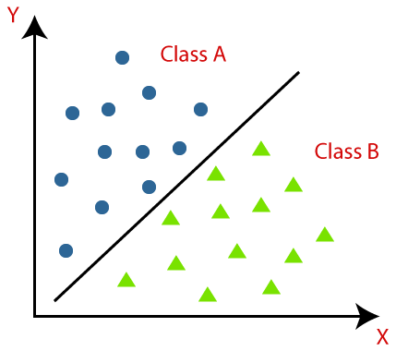
INTRO TO ML /ML CLASSIFACTION:
Classification is a process of categorizing a given set of data into classes, It can be performed on both structured or unstructured data. The process starts with predicting the class of given data points. The classes are often referred to as target, label or categories
the ml classification is devided into to category a)Binary b)multiclass
And we are going to solve a multiclass classifaction.

Slide 4
PROBLEM STATEMENT
A newly launched mobile company wants to determine the relation between features of a mobile phone (RAM, internal memory etc.) and it’s selling price and determine the price range for the mobile phones to be launched.

Slide 5
DATA SUMMARY:
Battery_power - Total energy a battery can store in one time measured in mAh
Blue - Has bluetooth or not
Clock_speed - speed at which microprocessor executes instructions
Dual_sim - Has dual sim support or not
Fc - Front Camera mega pixels
Four_g - Has 4G or not
Int_memory - Internal Memory in Gigabytes
M_dep - Mobile Depth in cm
Mobile_wt - Weight of mobile phone
N_cores - Number of cores of processor
Pc - Primary Camera mega pixels
Px_height - Pixel Resolution Height
Px_width - Pixel Resolution Width
Ram - Random Access Memory in Mega Bytes
Sc_h - Screen Height of mobile in cm
Sc_w - Screen Width of mobile in cm
Talk_time - longest time that a single battery charge will last when you are
Three_g - Has 3G or not
Touch_screen - Has touch screen or not
Wifi - Has wifi or not
Price_range - This is the target variable with value of 0(low cost), 1(medium cost),2(high cost) & 3(very high cost).

Slide 6
DATA CATAGORIZATION
Physical features
Fc | Front Camera mega pixels
pc | Primary Camera mega pixels
px_height | Pixel Resolution Height
px_width | Pixel Resolution Width
Touch_screen | Touch screen or not
mobile_wt | Weight of mobile phone
c_h | Screen Height of mobile in cm
sc_w | Screen Width of mobile in cm
m_dep | Mobile Depth in cm
Performance related Features
battery_power | Total energy a battery can store in one time measured in mAh
alk_time | longest time that a single battery charge will last when you are
clock_speed | Speed at which microprocessor executes instructions
n_cores | Number of cores of processor
RAM | Random Access Memory in Megabytes
int_memory | Internal Memory in Gigabytes
Network related Features
dual_sim | Has dual sim support or not
four_g | Has 4G or not
three_g | Has 3G or not
Blue | Has Bluetooth or not
Wifi | Has wifi or not
Dataset size:
2000 rows and 21 features

Slide 7
DATA DESCRIPTION
Number of rows:2000
Number of columns:21
Missing values:0
Missing values (%):0%
Checking Duplicate values: 0
All are numerical type data

Slide 8
FEATURE ENGINEERING
Screen size
Column ‘screen size’ was created combining screen height and screen width
PPI
Column ‘PPI’(Pixels Per Inch) was created combining pixel height and pixel width along with screen size
4G/3G
Columns 3G and 4G were combined to create column ‘4G/3G’

Slide 9
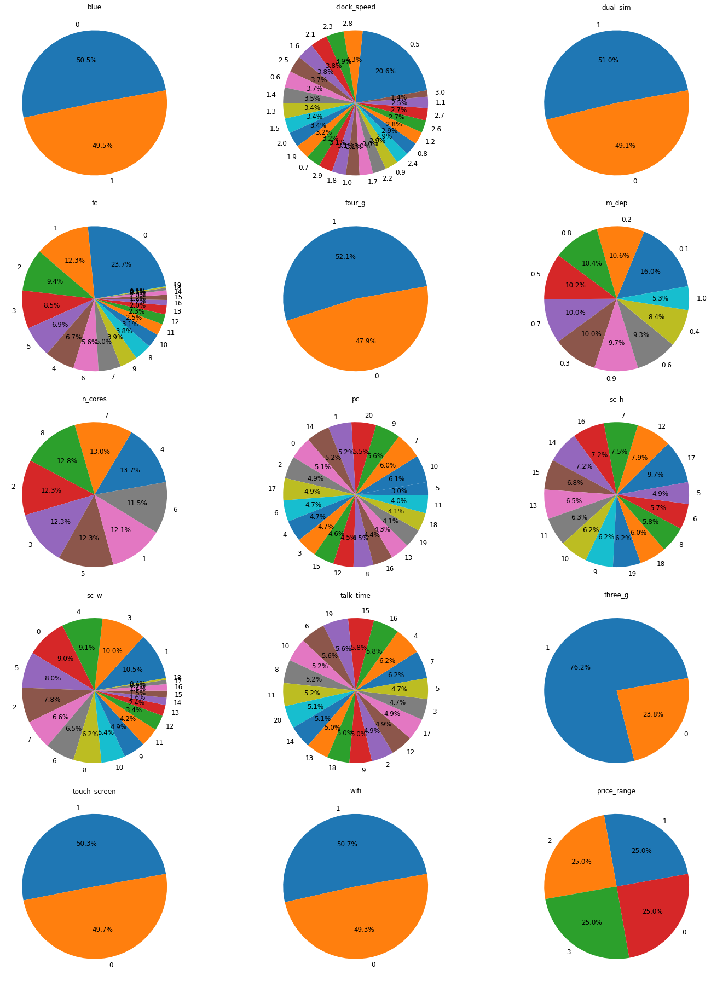
EXPLORATORY DATA ANALYSIS univariate analysis:
1. 50.5%-not bluetooth and 49.5%-bluetooth mobiles data present
2. 51% - Dual sim & 49.1% no-dual sim mobiles are present
3.52.1%- 4g & 47.9% not4g are present

Slide 10
Cont..
4.maximum 4 core processsor are present as compair to other but the 2,3,5 are same in counts,and the 6core processor are less in count.
5.3g phone are 78.2% and the non3g are 23.8%
6.there are 50.3% of touch screen phone are hear and the rest are non touch screen
7.50.7% of wifi phone are present and rest are wifi less phone
8.price is equaly prsent as (low,high,medium,expensive)

Slide 11
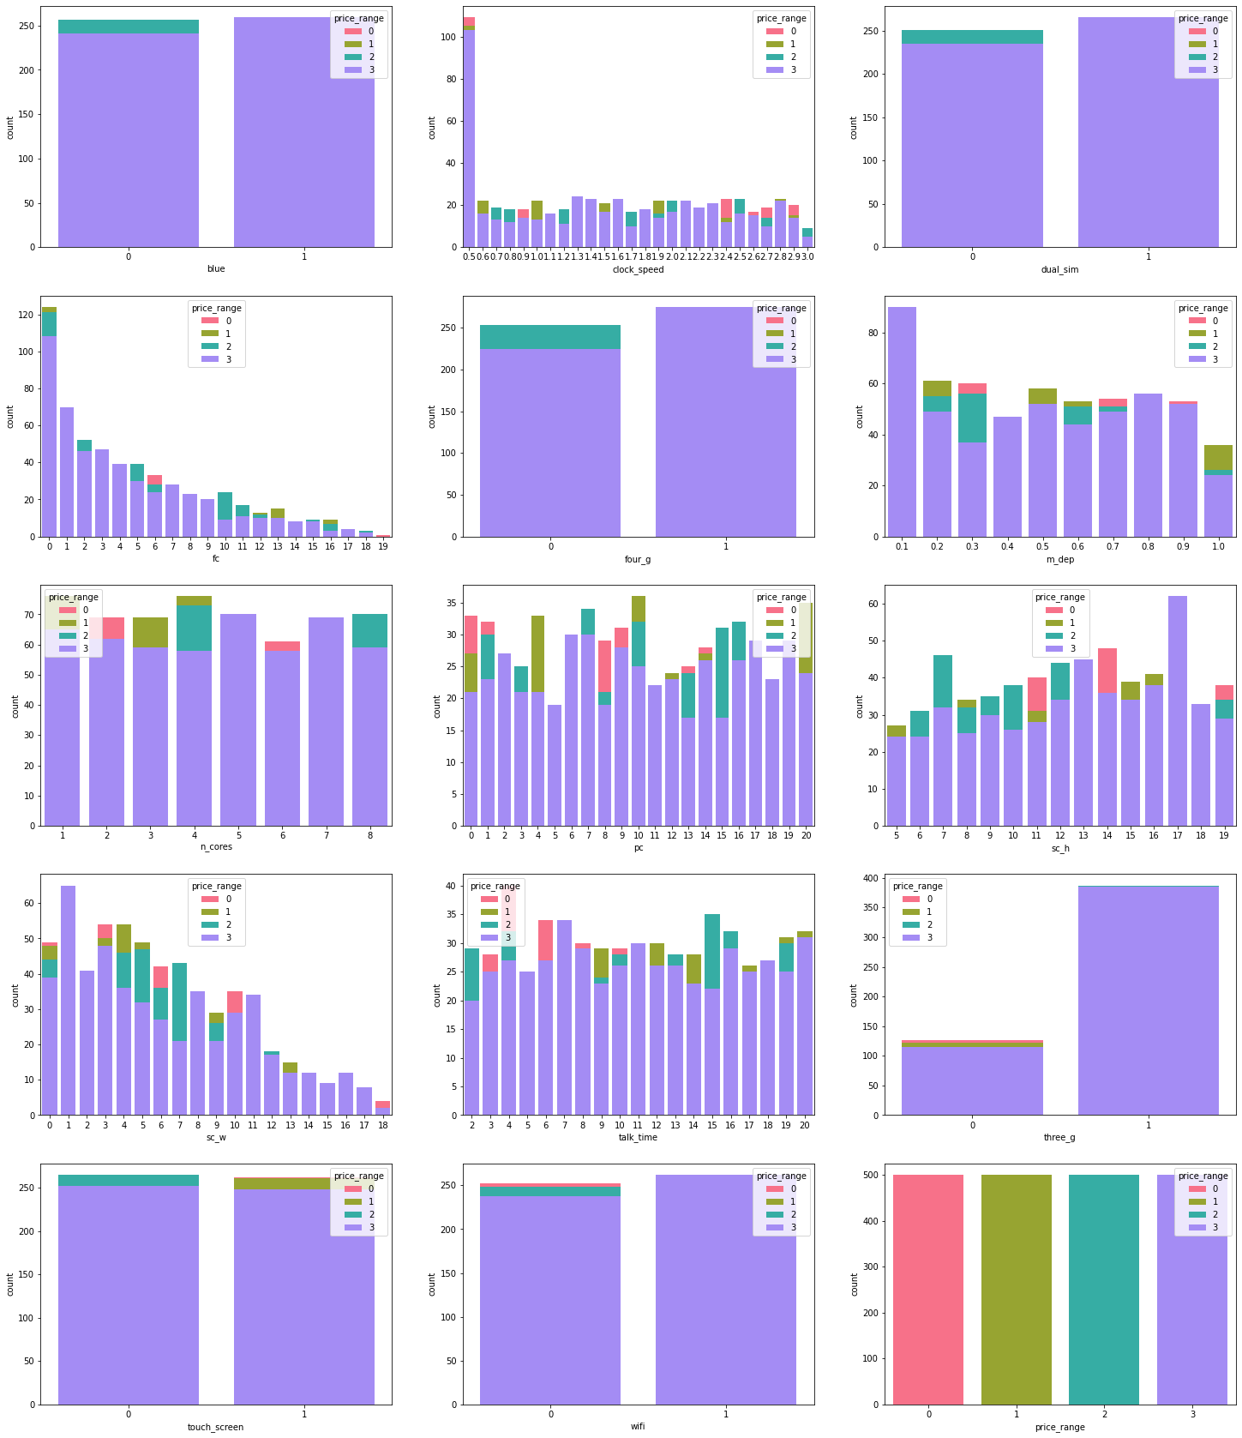
BIVARIATE ANALYSIS:

Slide 12
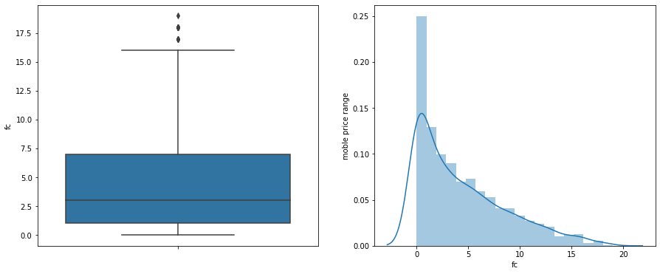
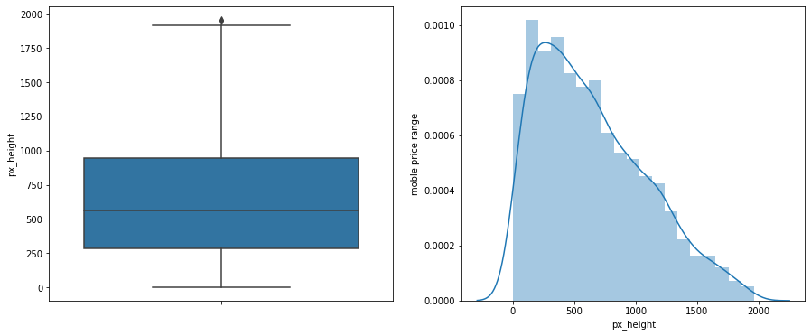
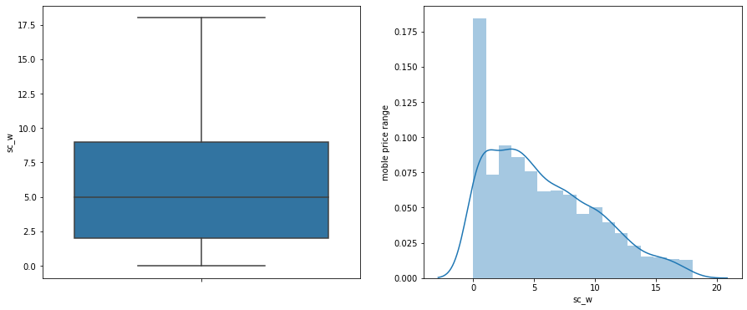
BEFORE ML STEPS OUT LIER & SKEWNESS CHECK
Applying log transformation
Applying IQR method

Slide 13
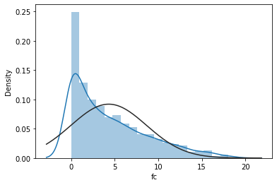
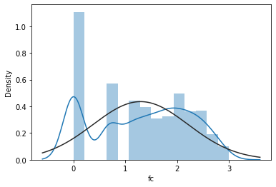
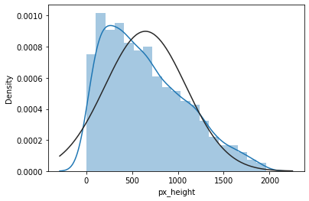
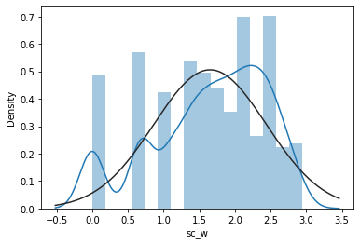
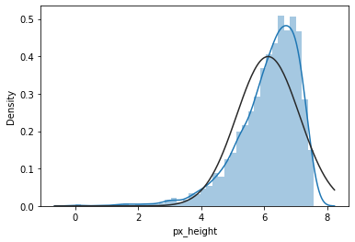
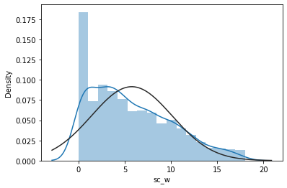
TREETMENT OF SKEWNESS:

Slide 14
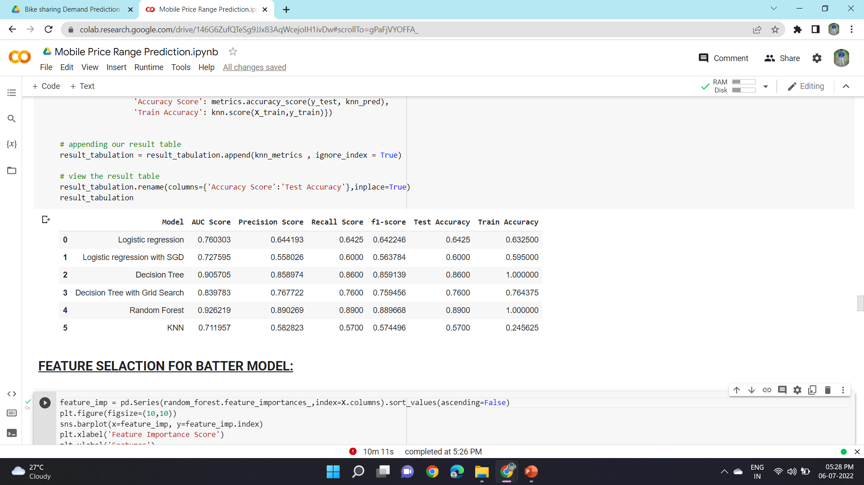
MODELLING
WITHOUT FEATURE SELACTION

Slide 15
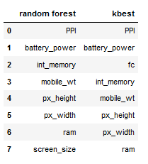
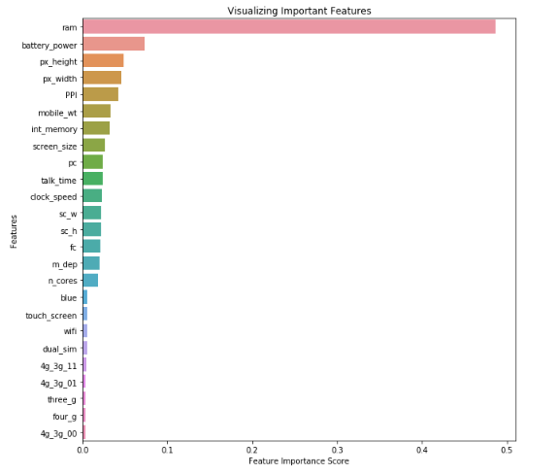
FEATURE SELACTION

Slide 16
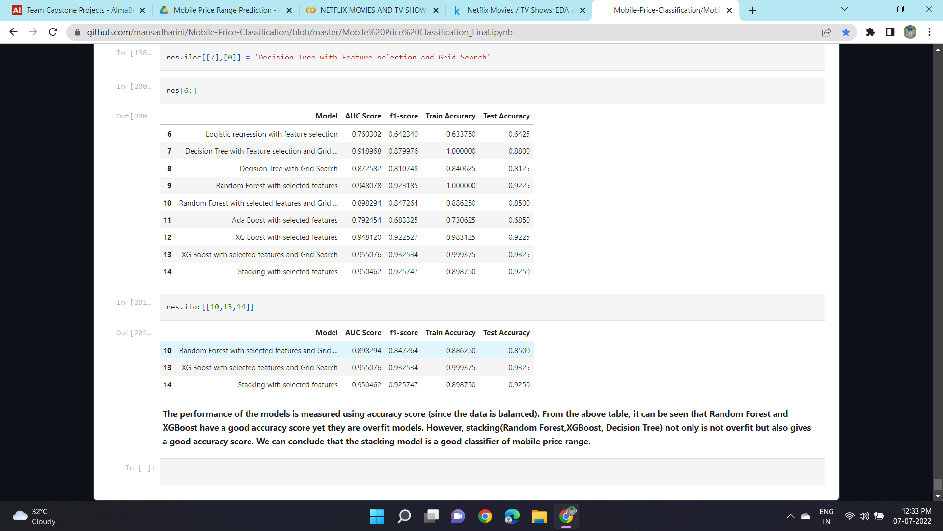
MODELLING
AFTER FEATURE SELECTION

Slide 17
BEST PERFORMING MODELS
From the above table, it is evident that the best model is Stacking Classifier with an accuracy of 91.51%.
The algorithms used in stacking classifier are:
Random Forest, Decision Tree and XG Boost Classifier on the first level
XG Boost Classifier on the second level.

Slide 18
Low performing algorithmS
High performing algorithms
Decision Tree
Logistic Regression
XGBoost
KNN
Random forrest

Slide 19
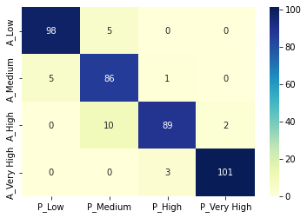
CONFUSION MATRIX OF BEST MODEL
As discussed in EDA, price range low and very high are accurately classified whereas the medium and high price ranges seem be a bit difficult to categorise.

Slide 20
CONCLUSION
1)The price range of mobiles is thus determined and the most important features are shown in the image to the right.
2)Most expensive/flagship phones as well as low-end phones can be well classified but there are minor overlaps in budget and mid range phones.
Price
Battery power
Internal memory
PPI
RAM

Slide 21
THANK YOU

